Slide 1
PHISHING ATTACK
Presented by:
Rishabh Ahuja
Khyati Anand
Samriddhi Motiani
Param Rawal
Presented to:
Dr.Abhaydeep Seth

Slide 2
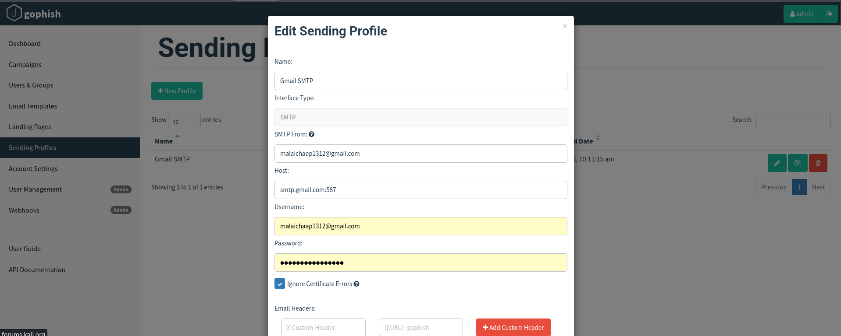
Step 1:Sending profile from which phishing mails are sent

Slide 3
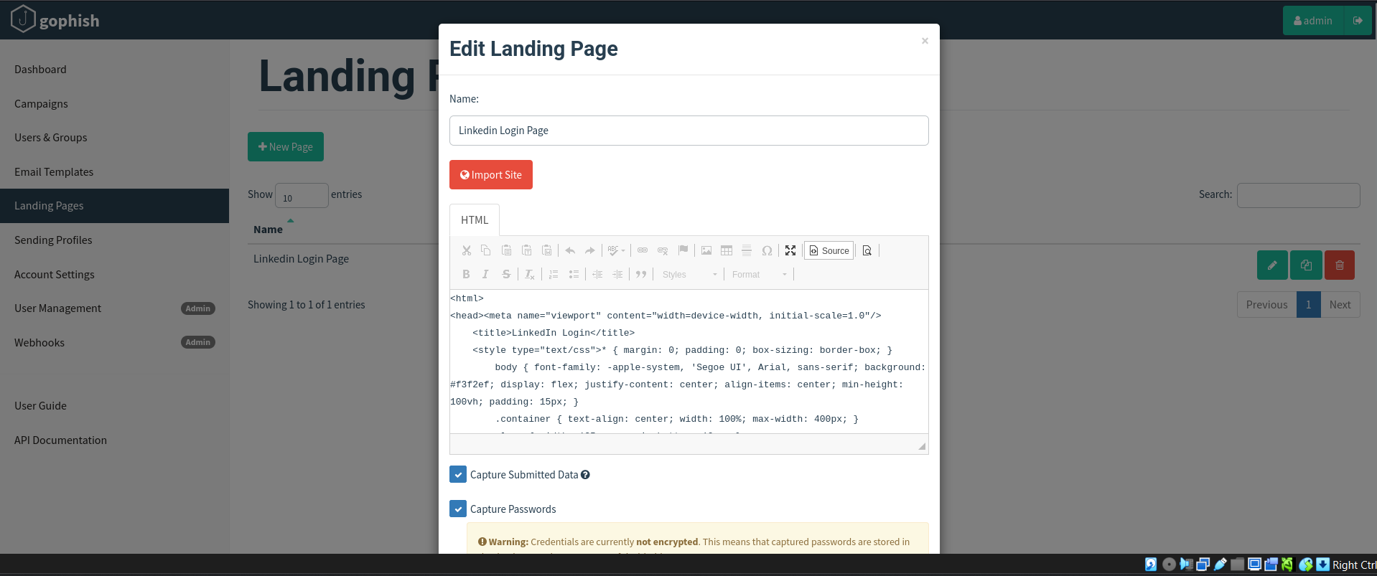
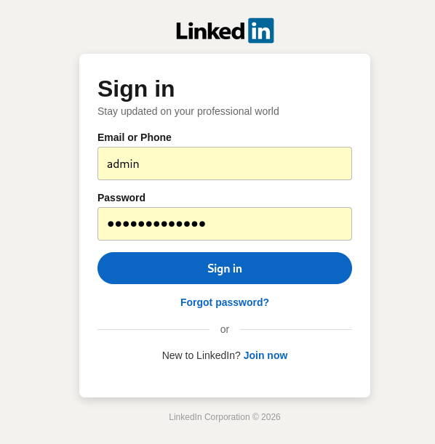
Step 2:Email SMTP

Slide 4
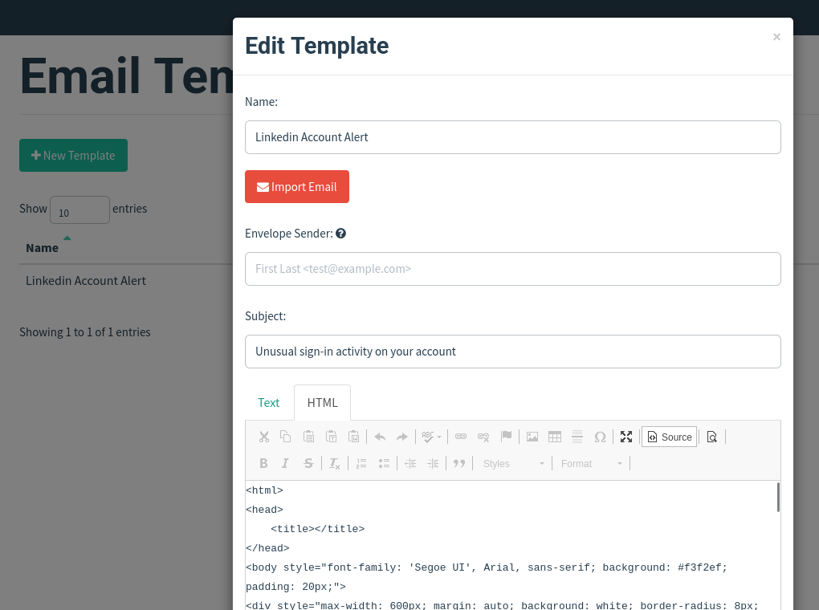
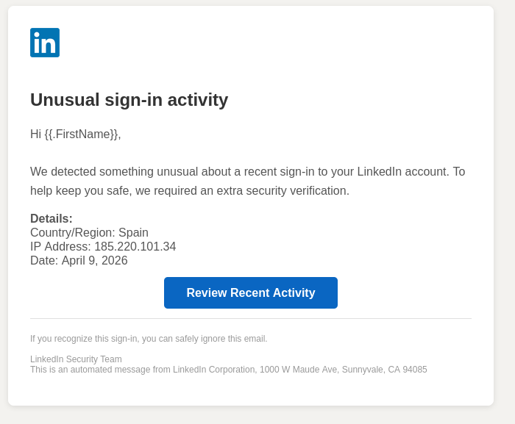
Step 3: Alert mail to user

Slide 5
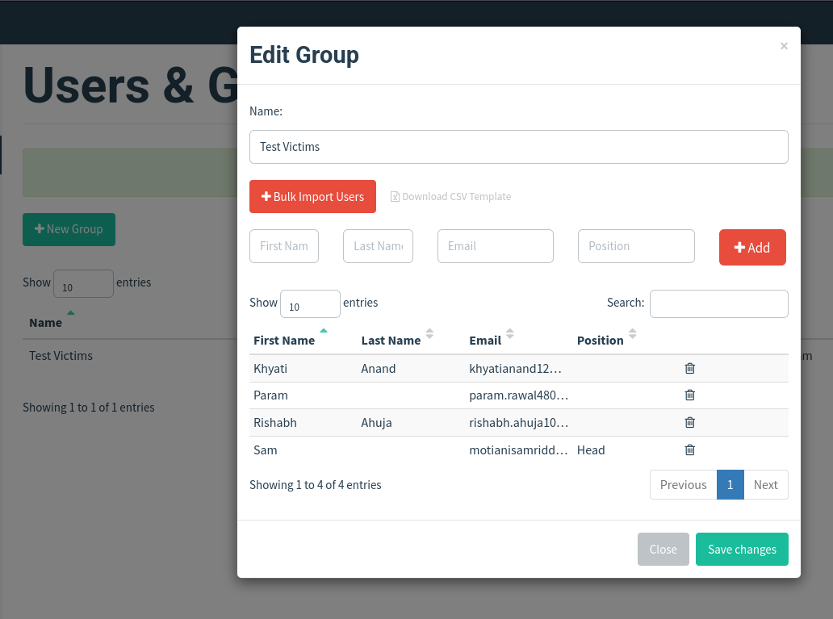
Step 4:Group creation

Slide 6
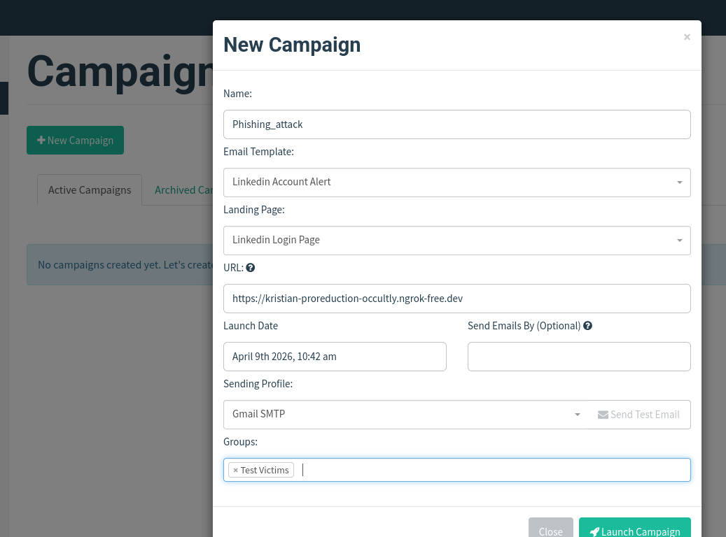
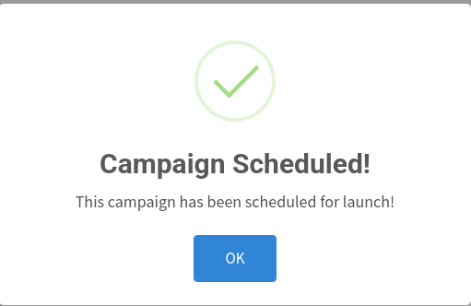
Step 5: Creating campaigns

Slide 7
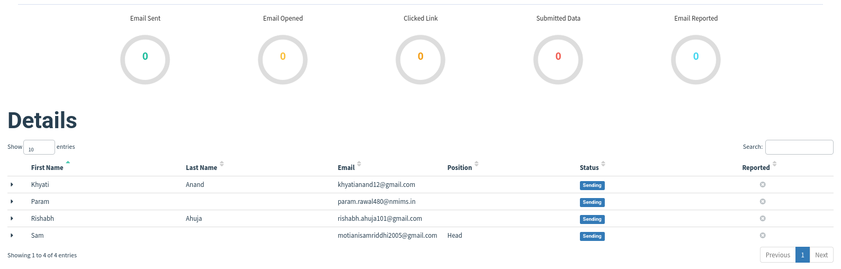
Step 6: GoPhish dashboard

Slide 8
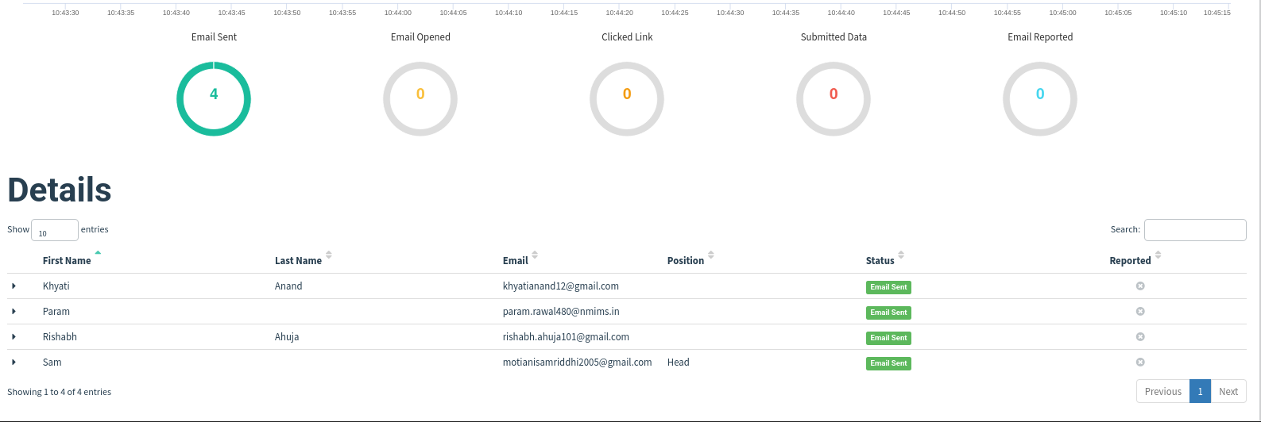
GoPhish dashboard after sending mail

Slide 9
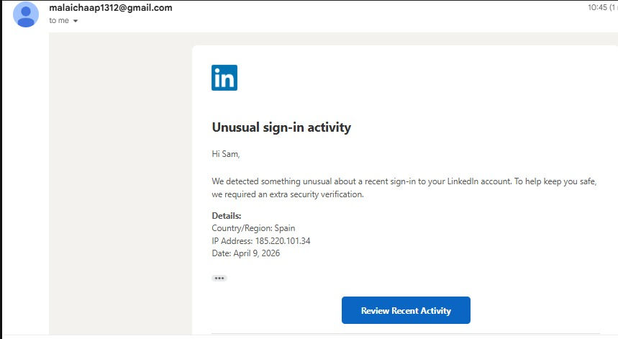
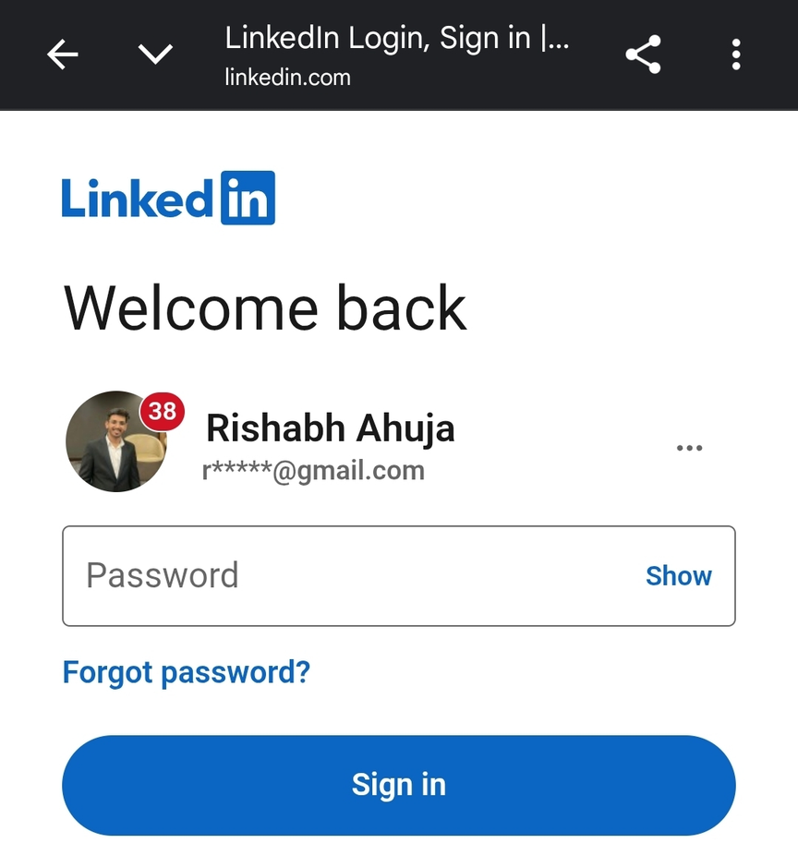
Step 7: Mail received by user

Slide 10
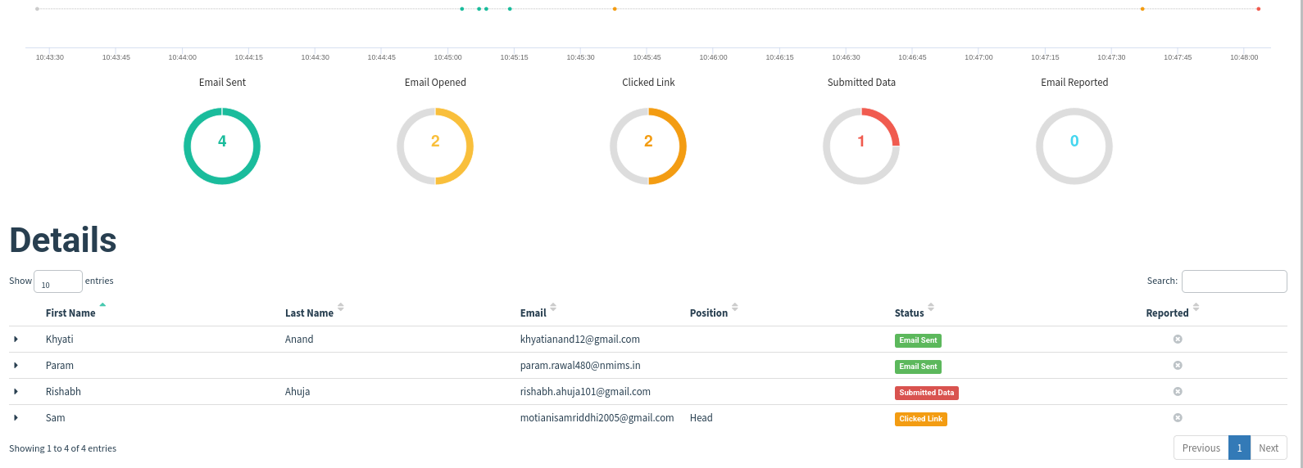
Step 8: Status of campaign

Slide 11
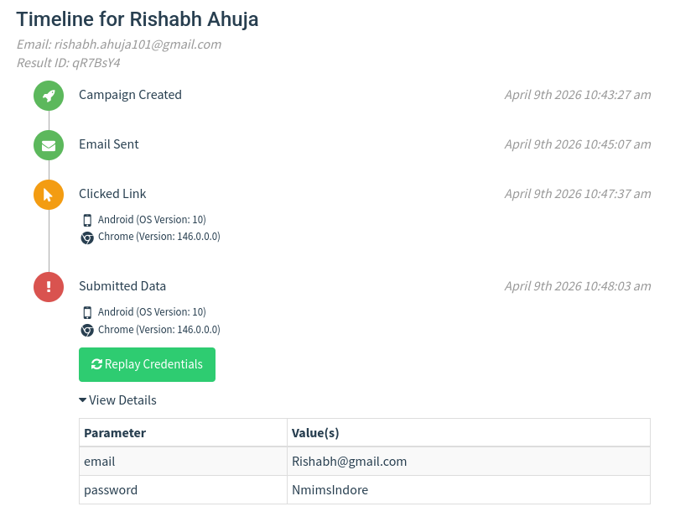
Information received on dashboard after user submitted data

